Slide 2
Conversation ground rules…
Listen to each other, all points of view and experiences are welcome!
Contribute to the conversation
Help all voices be heard
Follow the guidance of the moderator
We’re compassionate, these are very difficult times…
CHE Cook County Let’s Talk Public Health Feb 11, 2021: School Reopening (Slides Bloyd J)

Slide 3
Discussion Questions School Reopenings
What are Illinois teachers' unions doing about workplace and school community safety according to the Illinois Federation of Teachers?
What would be the effect on Covid inequities if other working populations had the power to improve workplace safety and conditions, such as meat packers or nursing home staff?
Is there a racial divide in families choosing in-school versus on-line classes, and if so why?
Are public health departments able to give advice to the public on opening schools that is independent of the policy position of the elected officials in their jurisdiction?

Slide 4
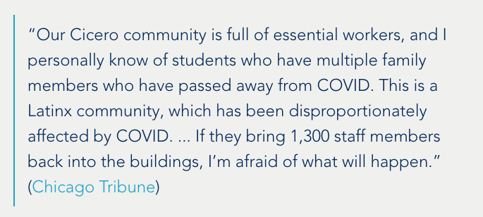
“…it is imperative to partner with unions to ensure a safe reopening... Teachers everywhere want to be in their classrooms with students, but safety must be the priority.”
Argo teachers file unfair labor practice: “The COVID positivity rate in Summit (as of January 11) is over 16%. That is more than double the 8% rate agreed to by the district and the union for a safe return to in-person instruction as recommended by the IDPH.”
demanding Illinois include higher education workers in Phase 1B for COVID vaccine
IFT Covid Tracker https://covidtracker.ift-aft.org/ crowdsourcing reports of health and safety violations and concerns
CHE Cook County Let’s Talk Public Health Feb 11, 2021: School Reopening (Slides Bloyd J)

Slide 5
“What’s at Stake in the Fight Over Reopening Schools”
“But the rush to get back to normal, by securing the child care necessary to truly open the economy, is coming into sharp conflict with many teachers, who want vaccines and airtight mitigation protocols before agreeing to return to schools. Most parents of Black and Latinx students share their concerns. According to one recent study, only eighteen per cent of Black parents and twenty-two per cent of Latinx parents would prefer to send their children back to in-person schooling full time, compared with forty-five per cent of white parents.”
CHE Cook County Let’s Talk Public Health Feb 11, 2021: School Reopening (Slides Bloyd J)

Slide 6
“What’s at Stake in the Fight Over Reopening Schools”
‘Instead of responding to the matrix of problems that are confronting the children of “#essentialworkers,” city and school administrators have chosen to make teachers the main culprit.’
CHE Cook County Let’s Talk Public Health Feb 11, 2021: School Reopening (Slides Bloyd J)

Slide 7
“What’s at Stake in the Fight Over Reopening Schools”
“The lack of trust is not just about the character of the powerful actors involved... parents’ and teachers’ trepidation about returning to school has everything to do with whether schools will consistently adhere to [a mitigation plan]”
CHE Cook County Let’s Talk Public Health Feb 11, 2021: School Reopening (Slides Bloyd J)

Slide 8
Evidence that is sometimes overlooked showing cause for concern in reopening schools …
Scientific Advisory Group for Emergencies (SAGE). Children’s Task and Finish Group: update to 4th Nov 2020 paper on children, schools and transmission. London: Government of the United Kingdom.
Bender, R. (2021). Europe’s Schools Are Closing Again on Concerns They Spread Covid-19; Countries are abandoning pledges to keep classrooms open as concerns mount over children’s capacity to pass on the virus. Wall Street Journal (Online).
Goldhaber, D., Imberman, S. A., Strunk, K. O., Hopkins, B., Brown, N., Harbatkin, E., & Kilbride, T. (2020). To What Extent Does In-Person Schooling Contribute to the Spread of COVID-19. Washington DC: National Center for Analysis of Longitudinal Data in Education Research.
Miron, O., Yu, K.-H., Wilf-Miron, R., Kohane, I., & Davidovitch, N. (2020). COVID-19 infections following physical school reopening. Archives of disease in childhood.
Harris, D. N., Ziedan, E., & Hassig, S. (2021). The Effects of School Reopenings on COVID-19 Hospitalizations. New Orleans, Louisiana: REACH: National Center for Research on Education Access and Choice, Tulane University.
CHE Cook County Let’s Talk Public Health Feb 11, 2021: School Reopening (Slides Bloyd J)

Slide 9
Scientific Advisory Group for Emergencies (SAGE). (December 17, 2020) Children’s Task and Finish Group: update to 4th Nov 2020 paper on children, schools and transmission. London: Government of the United Kingdom. Retrieved from https://assets.publishing.service.gov.uk/government/uploads/system/uploads/attachment_data/file/948617/s0998-tfc-update-to-4-november-2020-paper-on-children-schools-transmission.pdf
CHE Cook County Let’s Talk Public Health Feb 11, 2021: School Reopening (Slides Bloyd J)

